Slide 1

Tool
Problem
Hierarchical Risk Parity Method for Robust Portfolio Construction
David Hu
Jasper Wu
J Feng

Slide 2
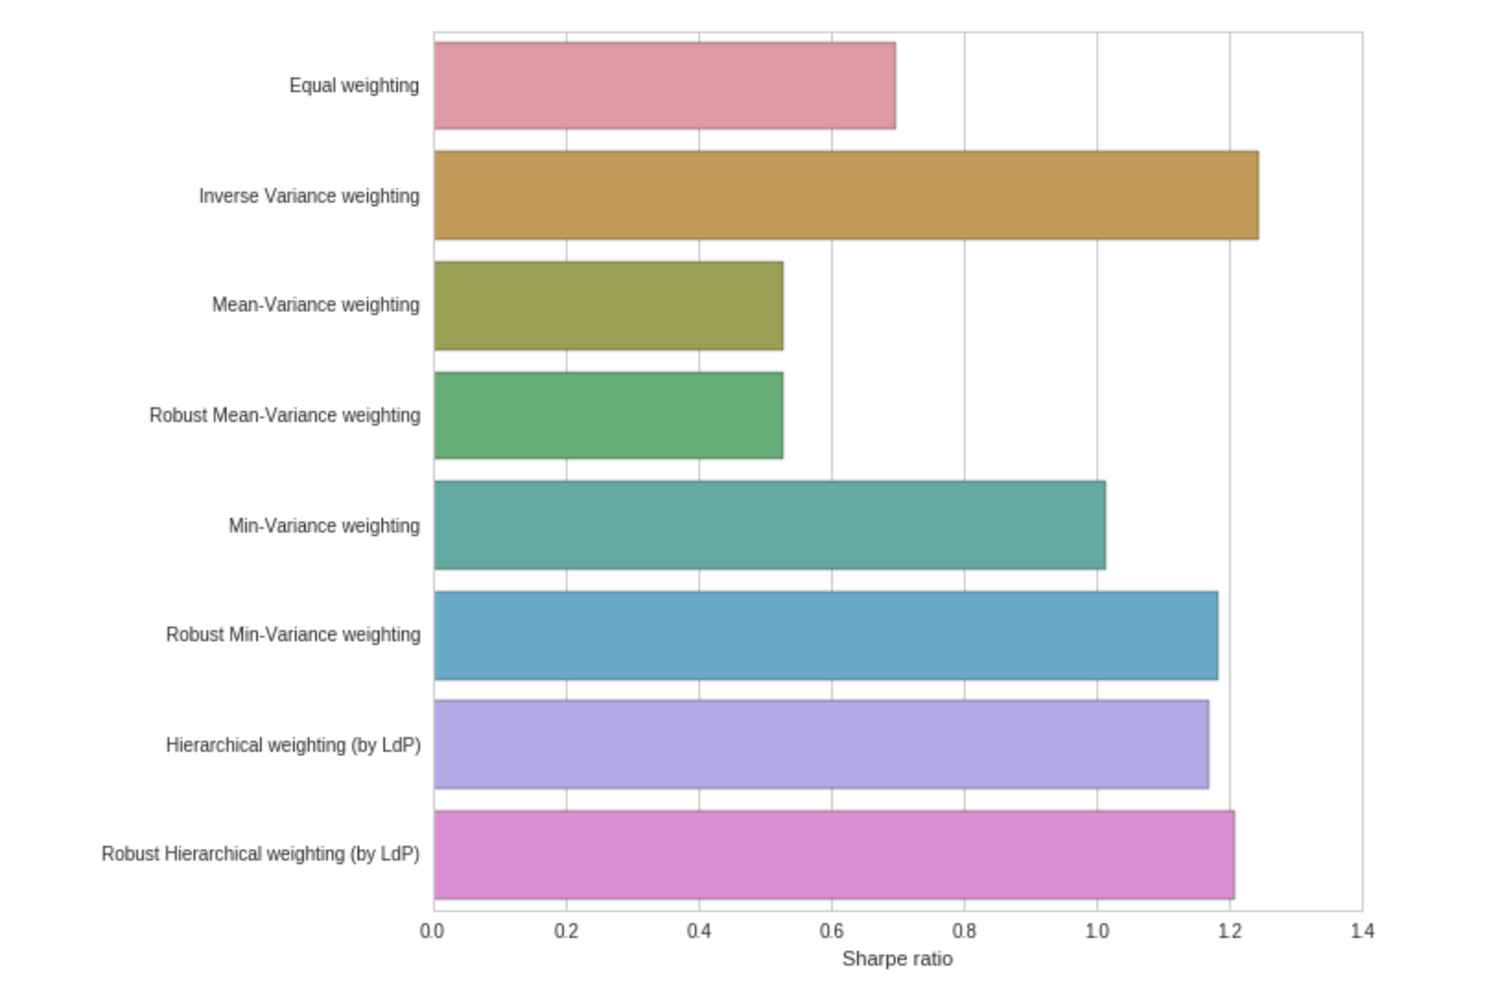
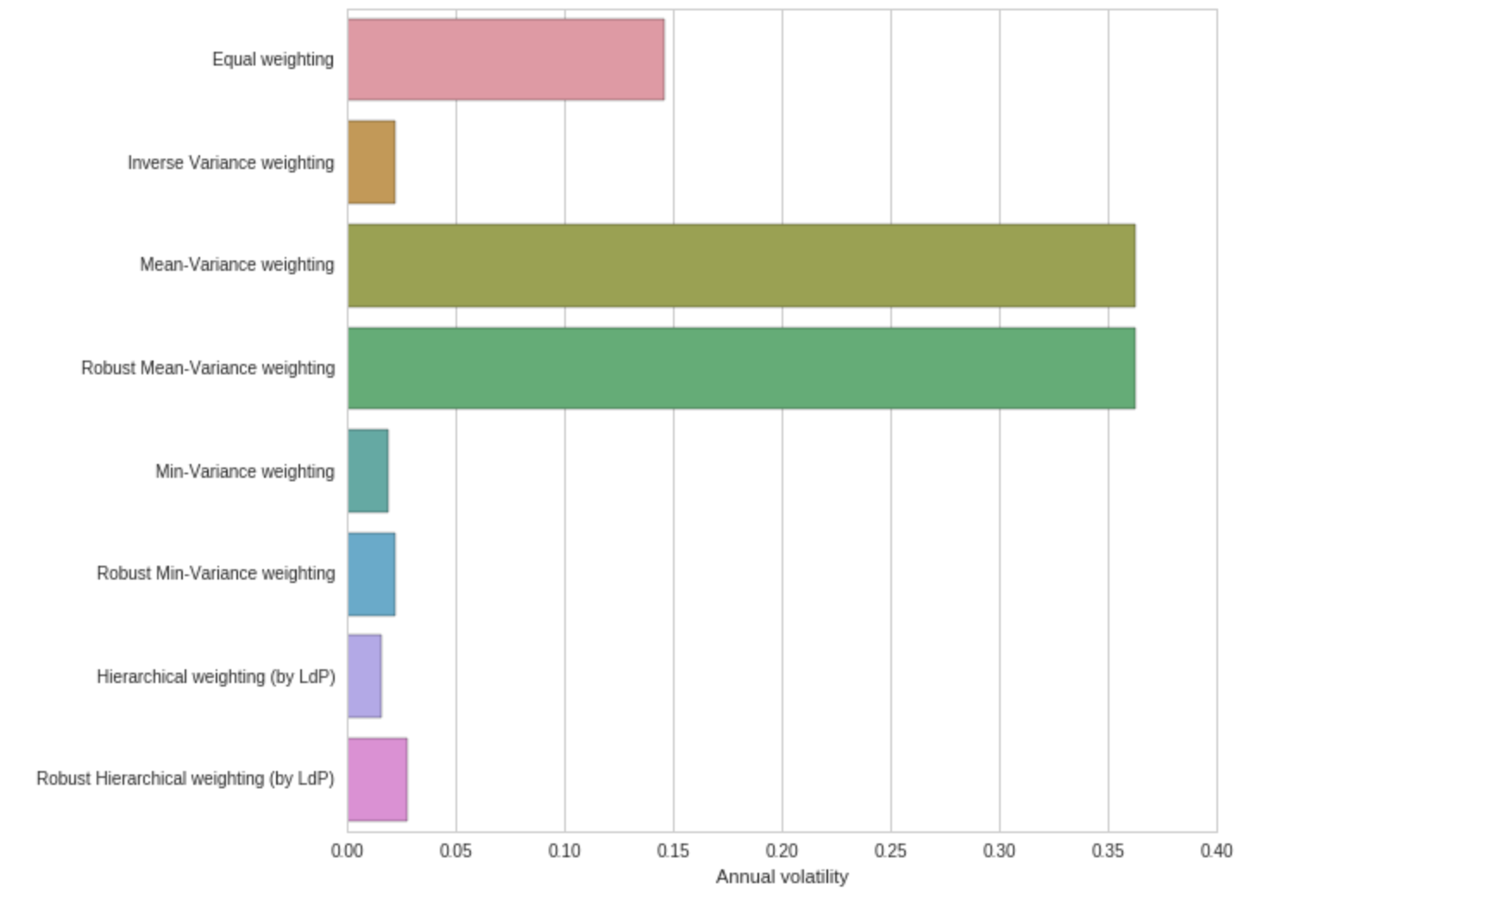
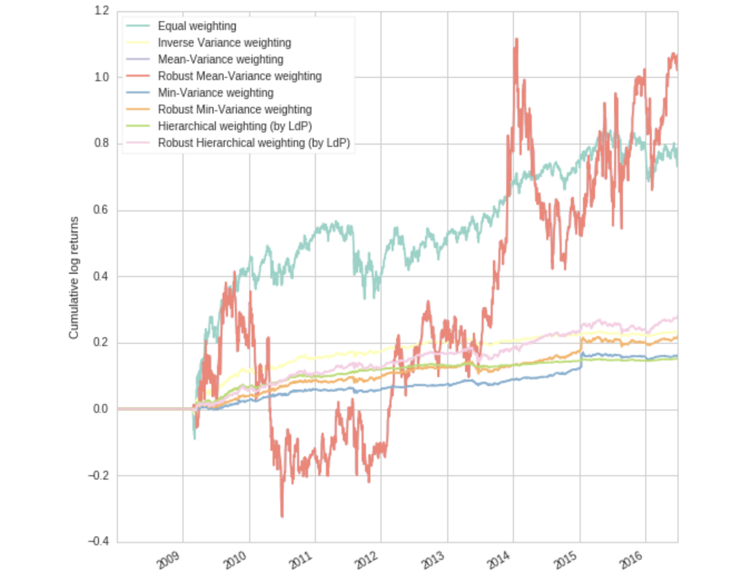
WHERE WE ARE
We have successfully implemented this portfolio construction method and have completed the back- testing process. From the back-testing result, we can see Hierarchical method indeed decreases the portfolio annual volatility and increases its Sharpe ratio.

Slide 3
Increasing the size of the covariance matrix, or the number of assets, will only makes matters worse.
Mean-Variance Method
Hierarchical Risk Parity

Slide 4
43 assets we choose:
Emerging Markets Index
Germany Index Fund
Government Bonds
Japanese Stocks
Intermediate-term U.S. Treasury bonds
Large and mid-sized companies in France
Large and mid-sized companies in the UK
Materials Sector
Energy Sector
Investment Grade Corporate Bond
Technology Sector
Utilities Sector
EX Japan ETF
China Large-cap ETF on Hong Kong Stock Exchange
Vanguard Europe All cap index
Vanguard Asia Pacific all-cap
SP500
20+ years treasury bond
Core US aggregate Bond etf
US dollar denominated investment grade corporate bonds
100 large-cap US equities
Individual Stocks from different sectors

Slide 5
Hierarchical Risk Parity Method

Slide 6
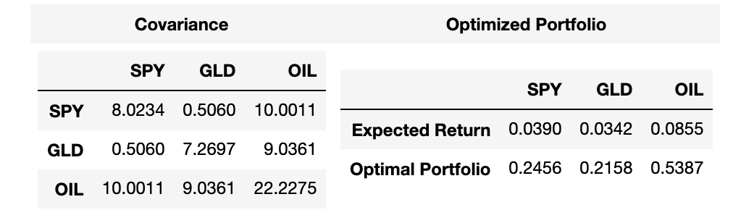
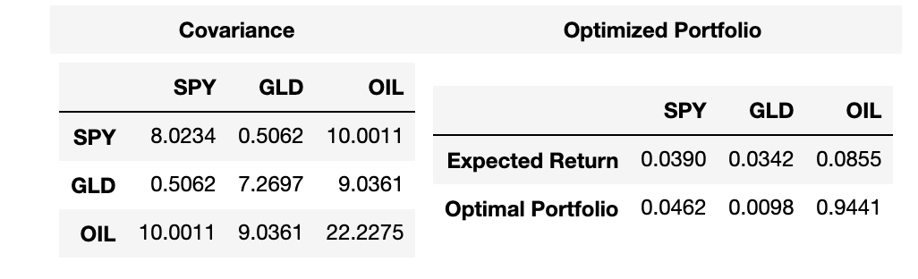
Drawbacks of using Markowitz and unmanipulated covariance matrix
The calculation of the portfolio weight requires the invertibility of the covariance matrix, so the portfolio constructed might suffer from instability if the covariance matrix is ill-degenerated.
Notes:
Instead, a matrix can be obtained from the sample covariance matrix through a transformation called shrinkage. This tends to pull the most extreme coefficients toward more central values, systematically reducing estimation error when it matters most.

Slide 7
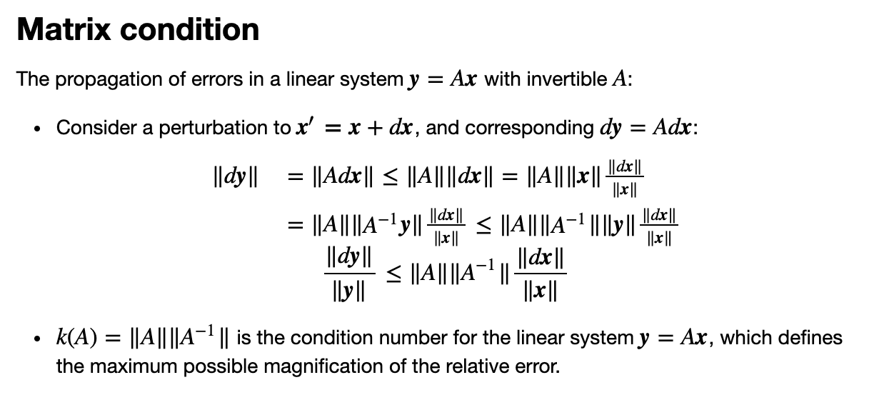
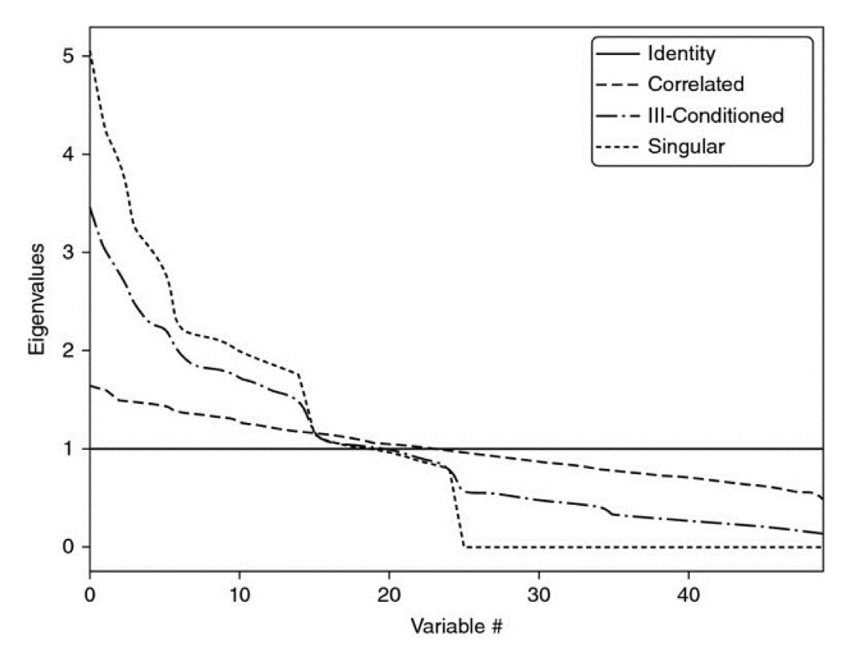
At some point, the condition number is so high that numerical errors make the inverse matrix too unstable: A small change on any entry will lead to a very different inverse. This is Markowitz’ curse: The more correlated the investments, the greater the need for diversification, and yet the more likely we will receive unstable solutions. The benefits of diversification often are more than offset by estimation errors.
Notes:
The larger the condition number, the larger the errors can be. It is equal to largest eigenvalue/ smallest eigenvalue.

Slide 8
Hierarchical Risk Parity Method Implementation: Uses Graph Theory and Clustering
Tree Clustering
Quasi-Diagonalization
Recursive-Bisection Weights Allocation

Slide 9
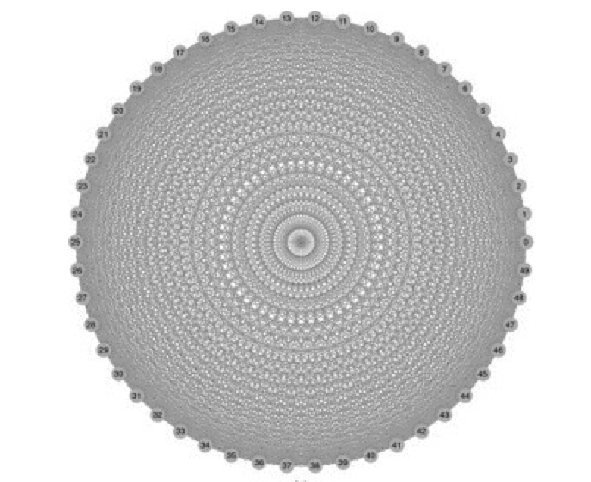
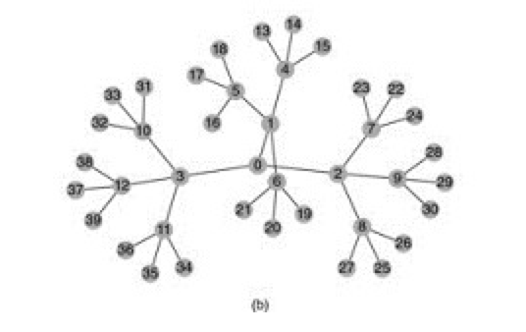
1. Tree Clustering
One reason for the instability of quadratic optimizers is that the vector space is modelled as a complete (fully connected) graph, where every node is a potential candidate to substitute another. In contrast, tree structures incorporate hierarchical relationship.
A tree structure has its advantage. It has only N-1 edges to connect N nodes, so the weights only rebalance among peers at various hierarchical levels.
This structure allows weights to vary freely in unintended way. All investments are potential substitutes to each other.

Slide 10
Example,
In deciding the allocation to a large publicly-traded U.S. financial stock like J.P. Morgan, we will consider adding or reducing the allocation to another large publicly-traded U.S. bank like Goldman Sachs, rather than a small community bank in Switzerland, or a real estate holding in the Caribbean.

Slide 11
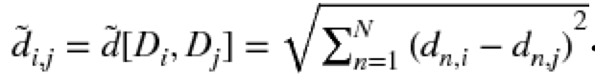
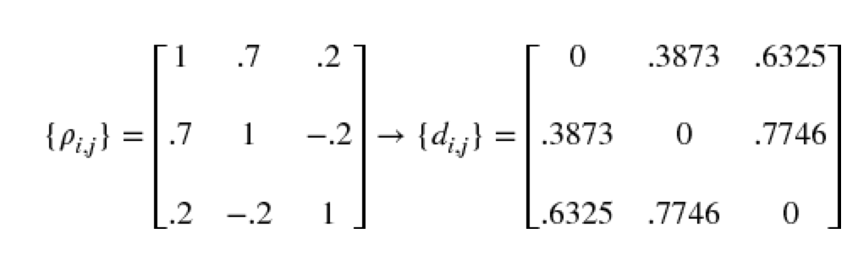
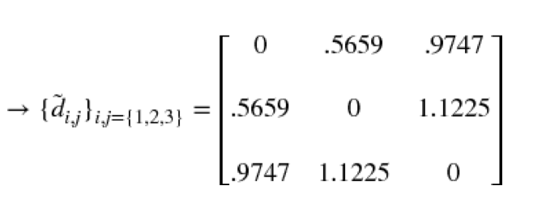
Tree-Clustering Method Implementation
NxN Correlation Matrix
NxN Distance Matrix
Euclidean Distance of Correlation
Distance

Slide 12
Procedure: We check the metrics, and if two investments are closely related, we put them into a cluster. Then we can
repeat this process until all assets are clustered. There are many ways to form the tree structure.
Perform single/min/nearest linkage on the condensed distance matrix y.
Perform complete/max/farthest point linkage on a condensed distance matrix.
Y-axis measures
the distance between the two merging leaves.

Slide 13
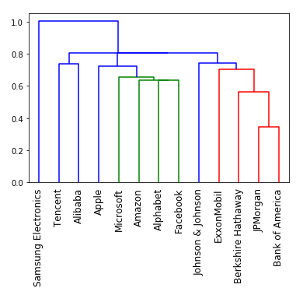

Slide 14
2. Quasi-Diagonalization
Similar investments are put close together and dissimilar investments are placed far apart. This stage reorganizes the structure of the covariance matrix without the change of basis.

Slide 15
2. Quasi-Diagonalization
Similar investments are put close together and dissimilar investments are placed far apart. This stage reorganizes the structure of the covariance matrix without the change of basis.

Slide 16
3. Recursive Bisection Allocation
Combine Inverse-Variance Method in the allocation process since it is optimal for a diagonal covariance matrix.
UUP 1
DHT 1
FRO 1
TNP 1
NAT 1
TNK 1
NYT 1
NKE 1
MSFT 1
IBM 1
AMX 1
XLK 1
SPY 1
DIA 1
XLB 1
XLE 1
FXI 1
EWU 1
EWG 1
EFA 1
EWQ 1
VGK 1
EWJ 1
VPL 1
EEM 1
EPP 1
BAC 1
XLF 1
JPM 1
XLU 1
UN 1
SNY 1
AAPL 1
AMZN 1
IEF 1
TLT 1
TIP 1
BND 1
LQD 1
IGSB 1
FXF 1
GLD 1

Slide 17
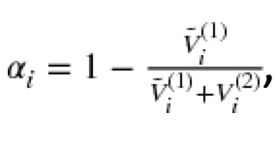
Using Inverse Variance Method to calculate the variance of each cluster
UUP 1
DHT 1
FRO 1
TNP 1
NAT 1
TNK 1
NYT 1
NKE 1
MSFT 1
IBM 1
AMX 1
XLK 1
SPY 1
DIA 1
XLB 1
XLE 1
FXI 1
EWU 1
EWG 1
EFA 1
EWQ 1
VGK 1
EWJ 1
VPL 1
EEM 1
EPP 1
BAC 1
XLF 1
Cluster Var1
Cluster Var2

Slide 19
WHERE WE ARE
We have successfully implemented this portfolio construction method and have completed the back- testing process. From the back-testing result, we can see Hierarchical method indeed decreases the portfolio annual volatility and increases its Sharpe ratio.

Slide 20
The patterns that stand out are that Mean-Variance optimization is not diversified at all as it just allocates everything to the ETF which had the highest mean-variance ratio over the last year. In addition, there are many numerical problems with performing the optimization, adding to the overall instability.

Slide 22
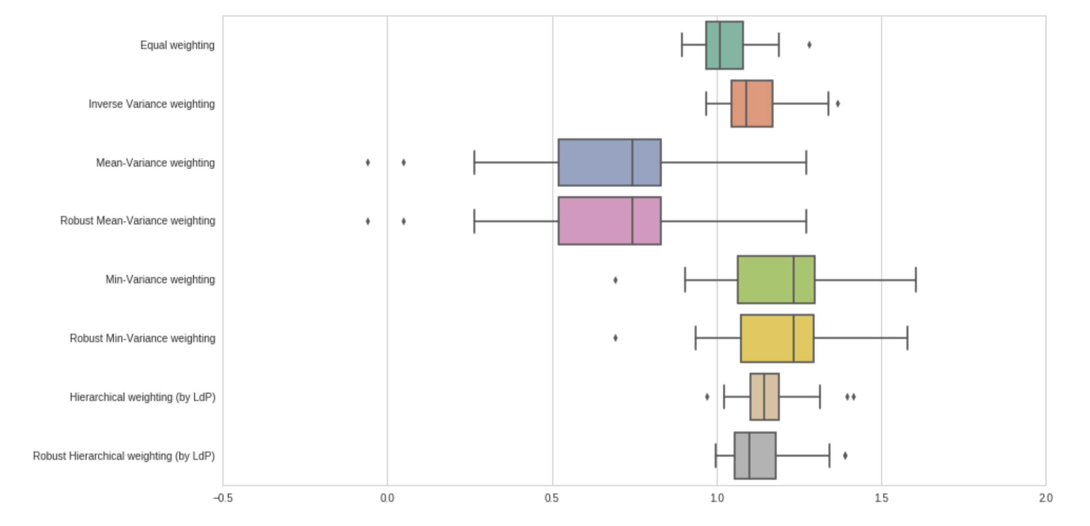
Sharpe Ratio

Slide 23
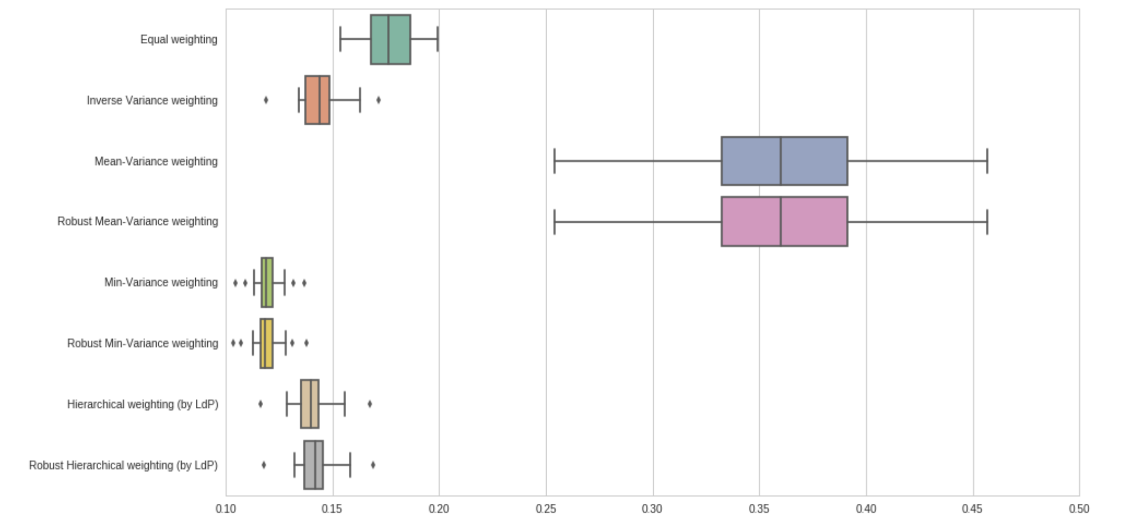
Volatility

Slide 24
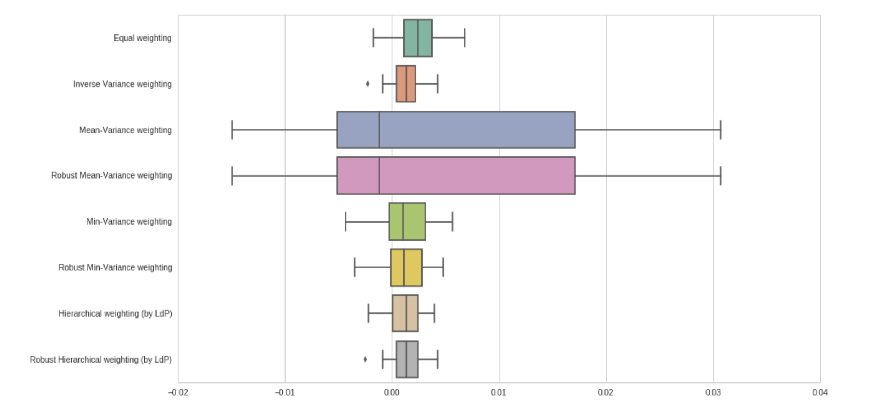
Returns

Slide 25
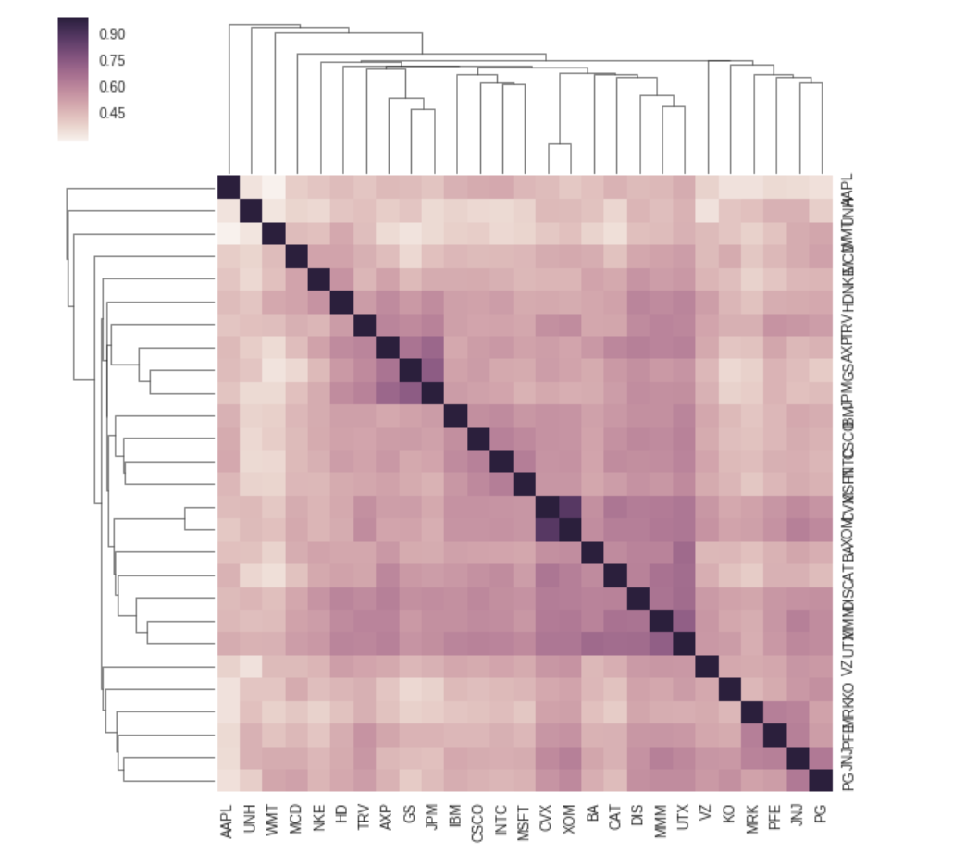
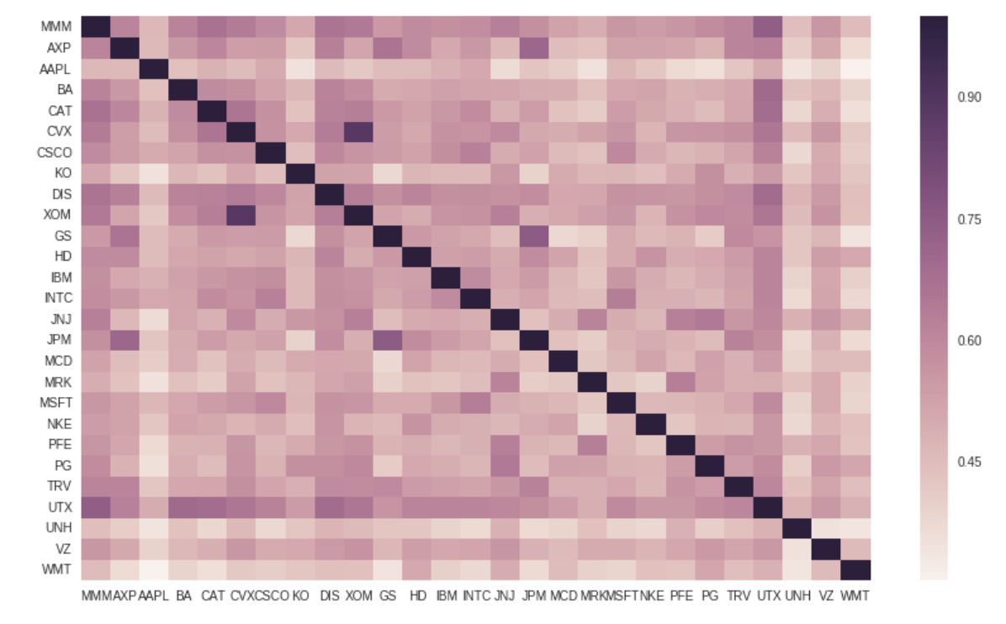

Slide 26
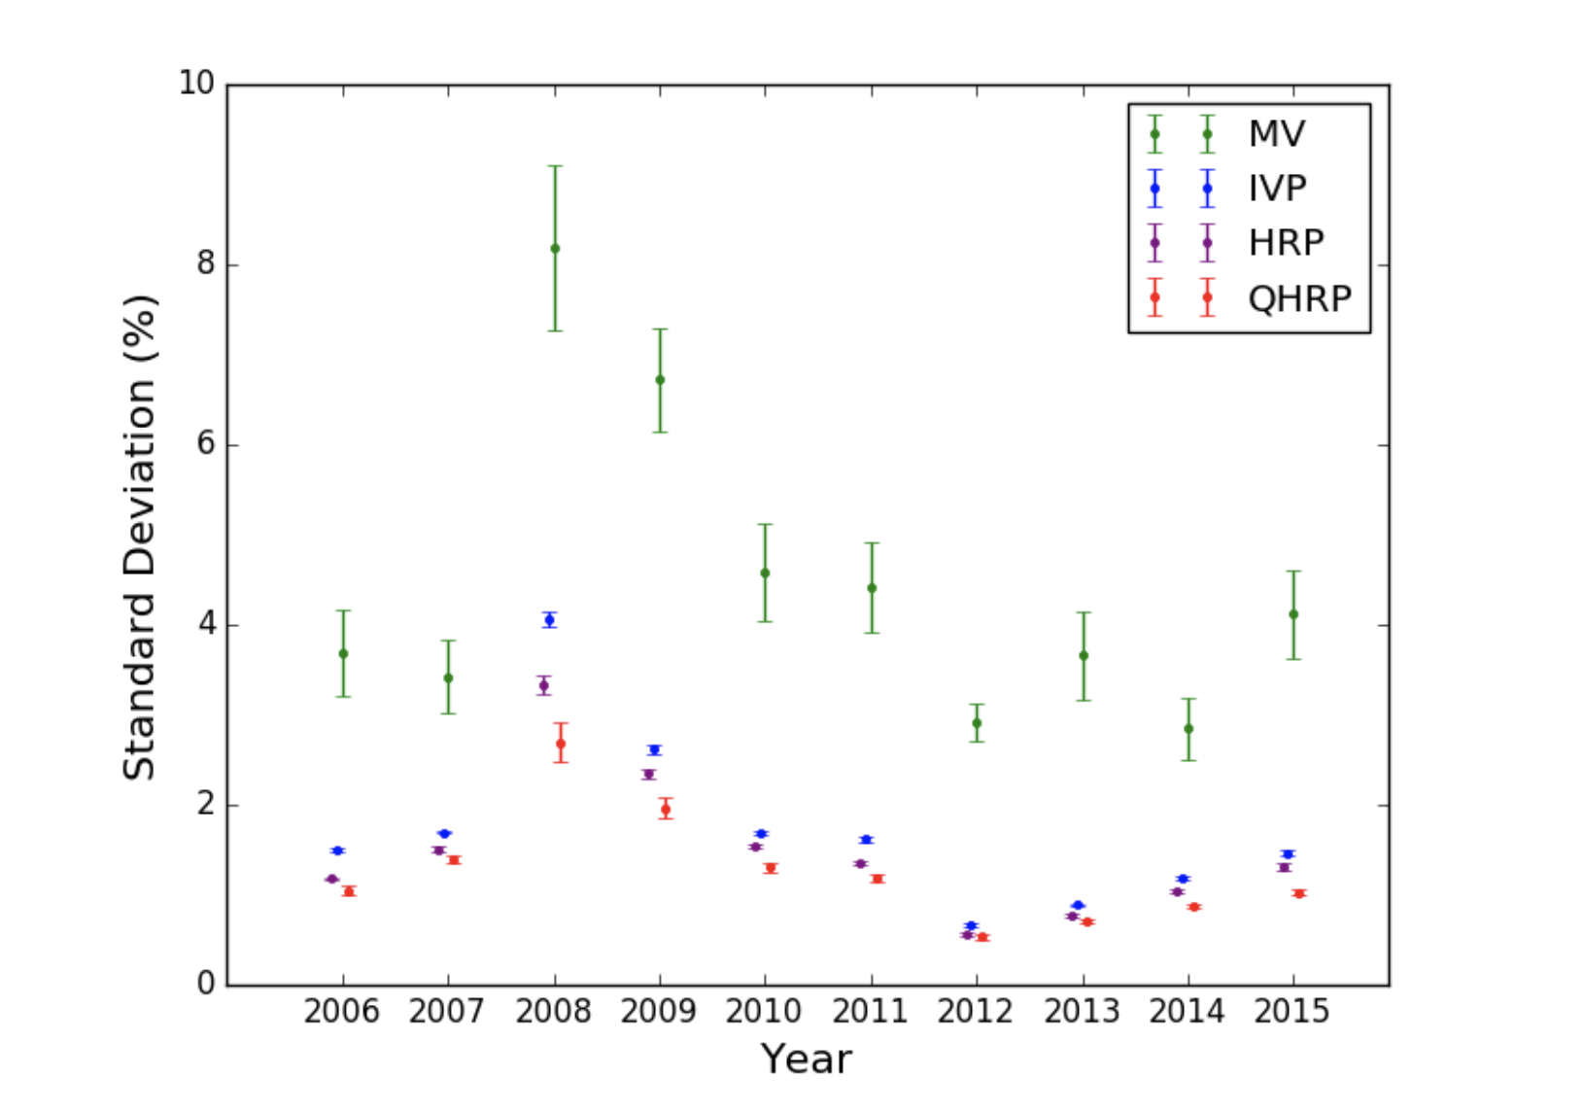
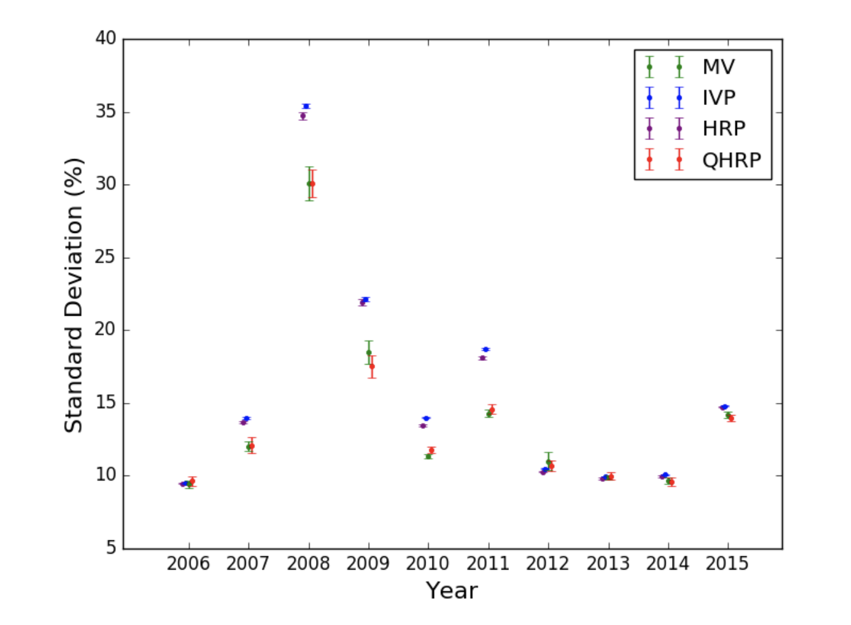
To highlight the ability of our method to exploit the hierarchical structure of assets, we focus our benchmarking on a universe of thirty-eight diverse futures contracts, including stocks and bonds from different countries, as well as commodities such as oil, wheat, and gold. We call this the CTA portfolio, because it is a fairly typical portfolio for a commodity trading advisor (CTA) to manage.
DJIA

Slide 27
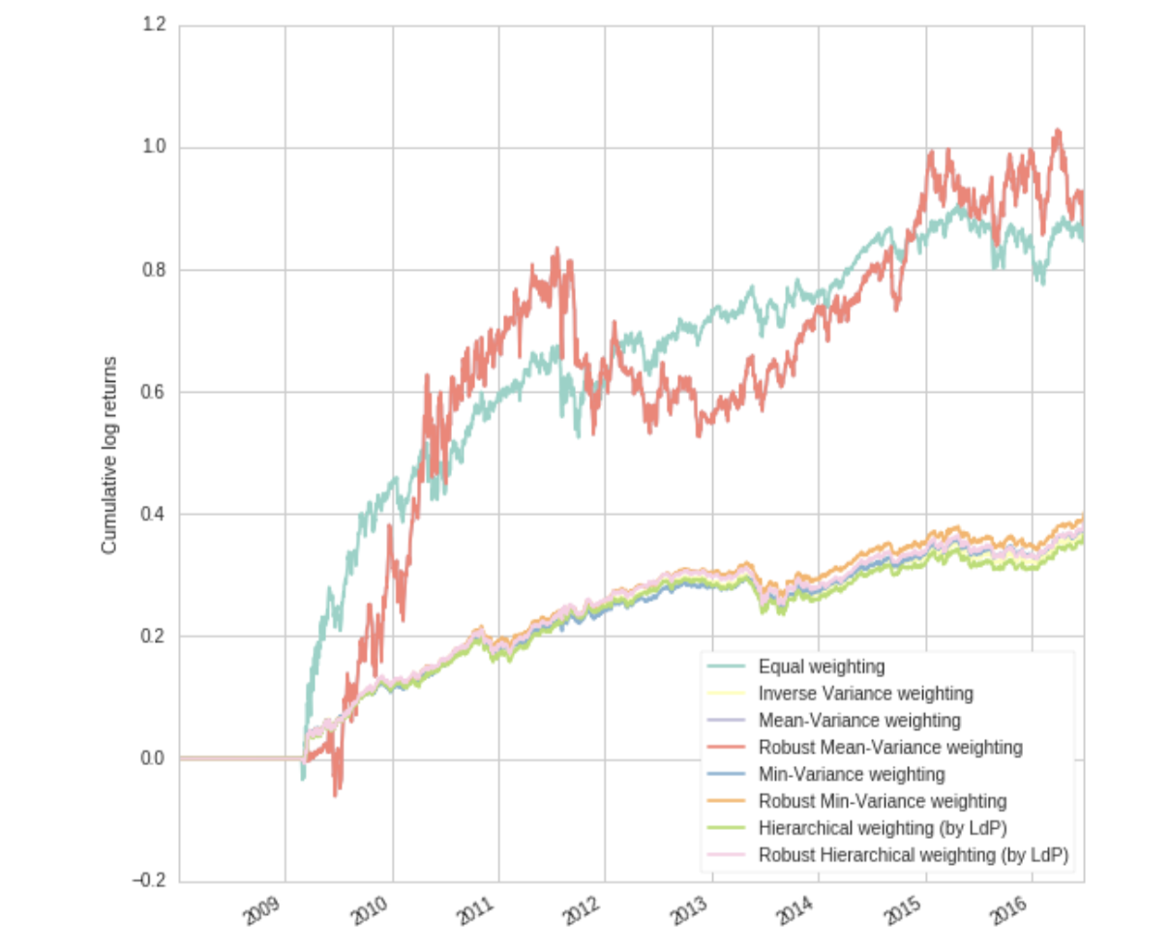
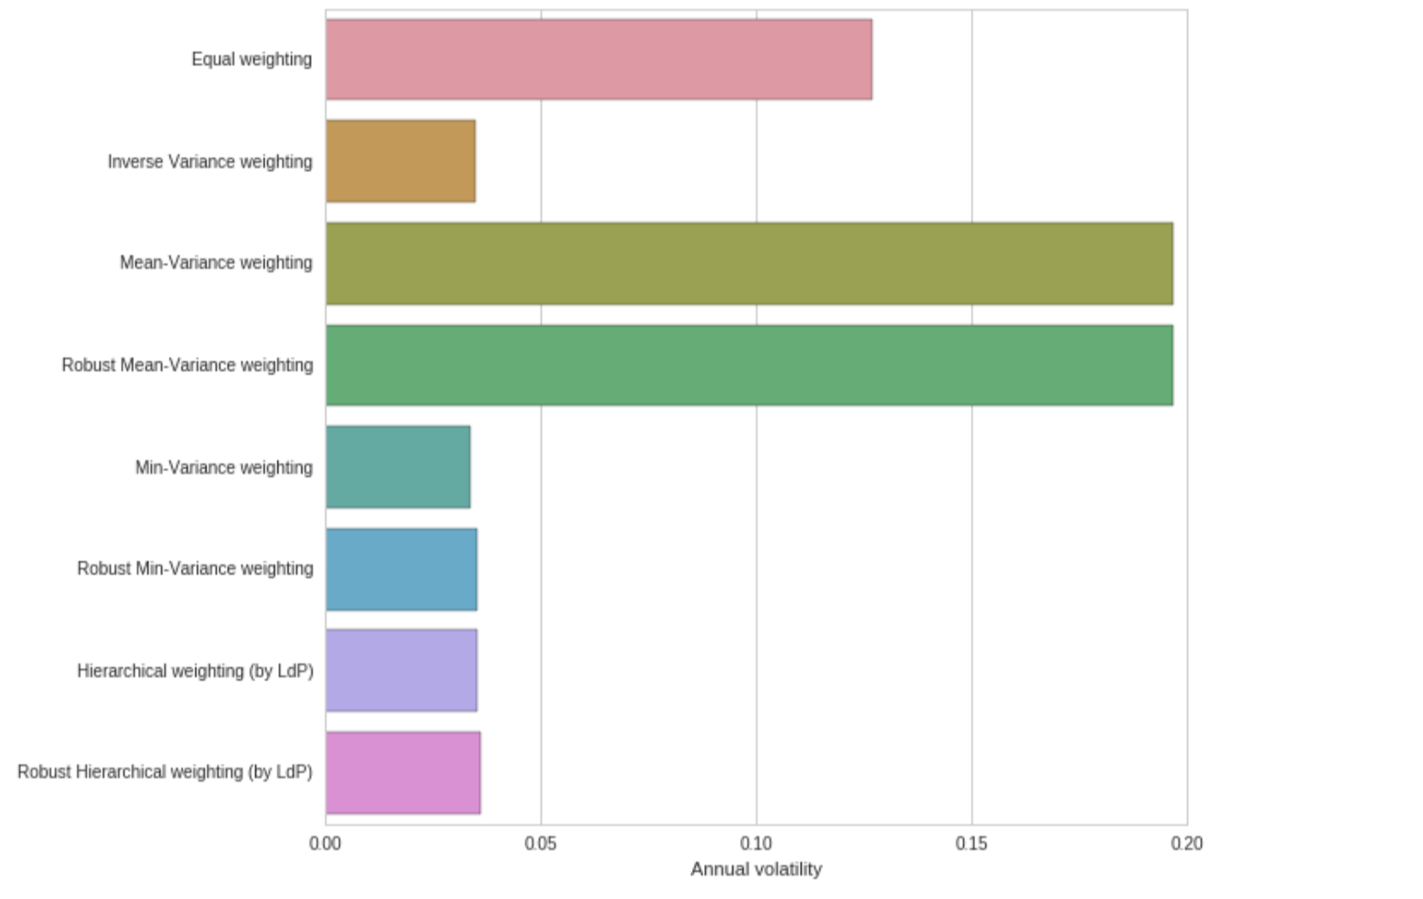
'AGG', # US Barclays Agg
'SPY’, # SP500
'EFA’, # Developed Equity Non US
'EEM', # Emerging Markets
'AVB’, # REITs
'TIP’ # Government Bonds

Slide 28
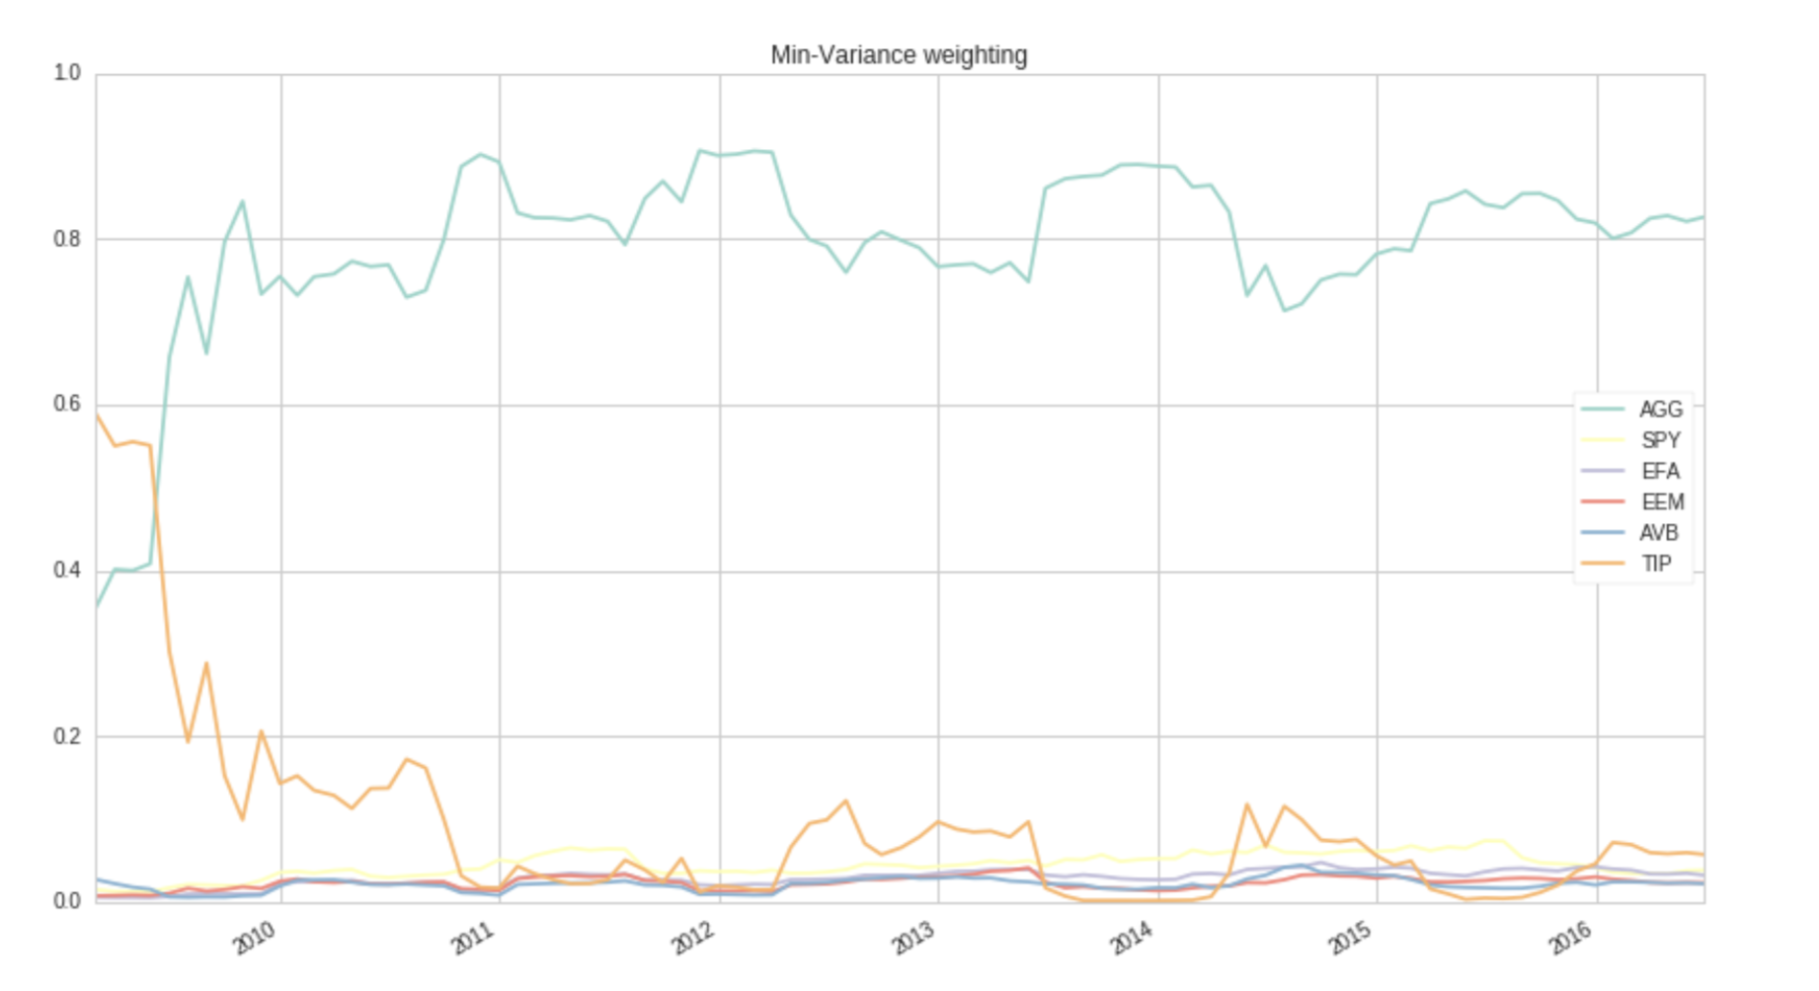
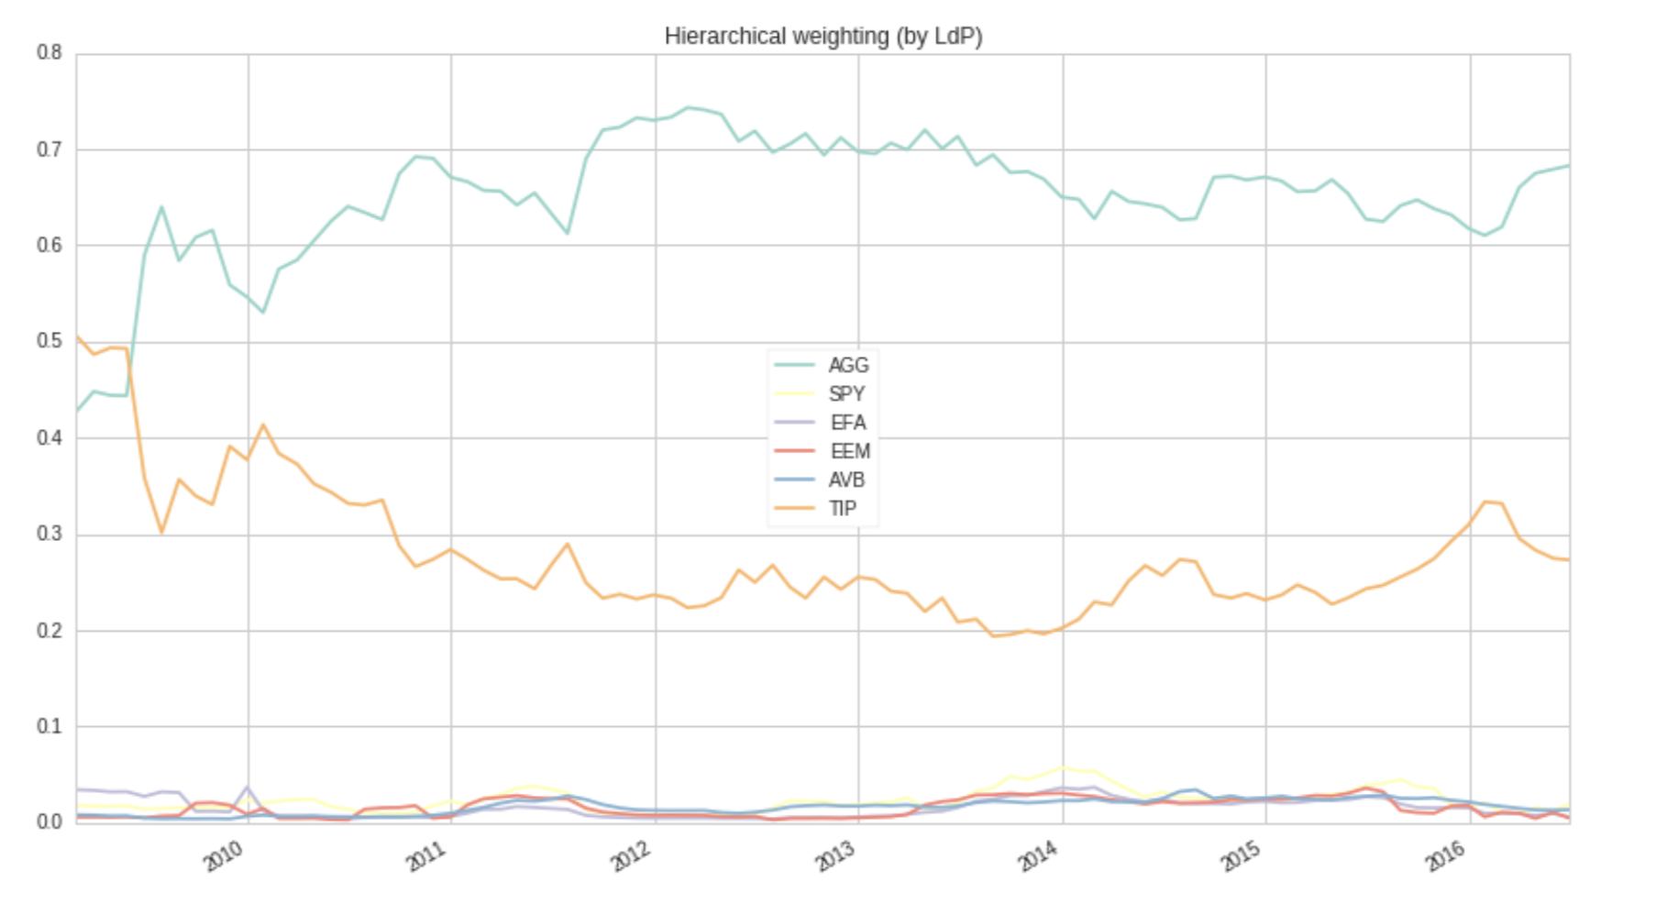
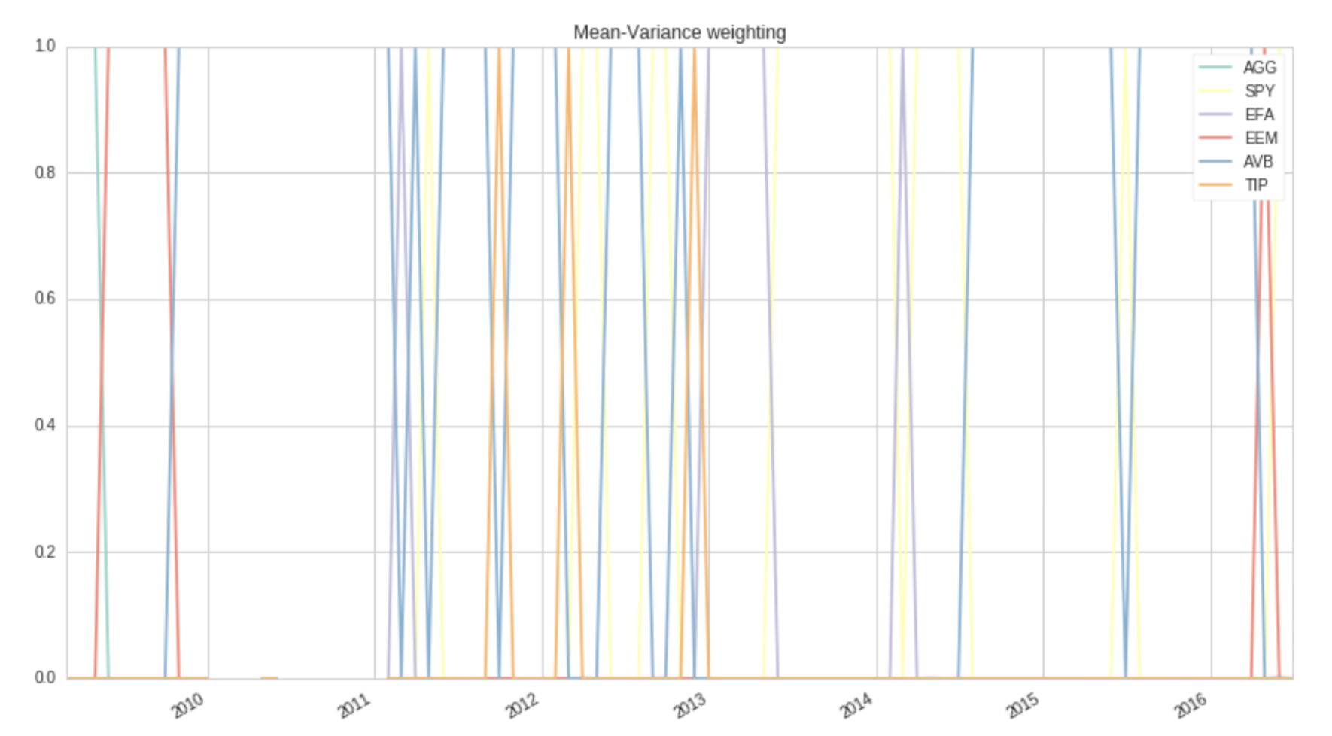
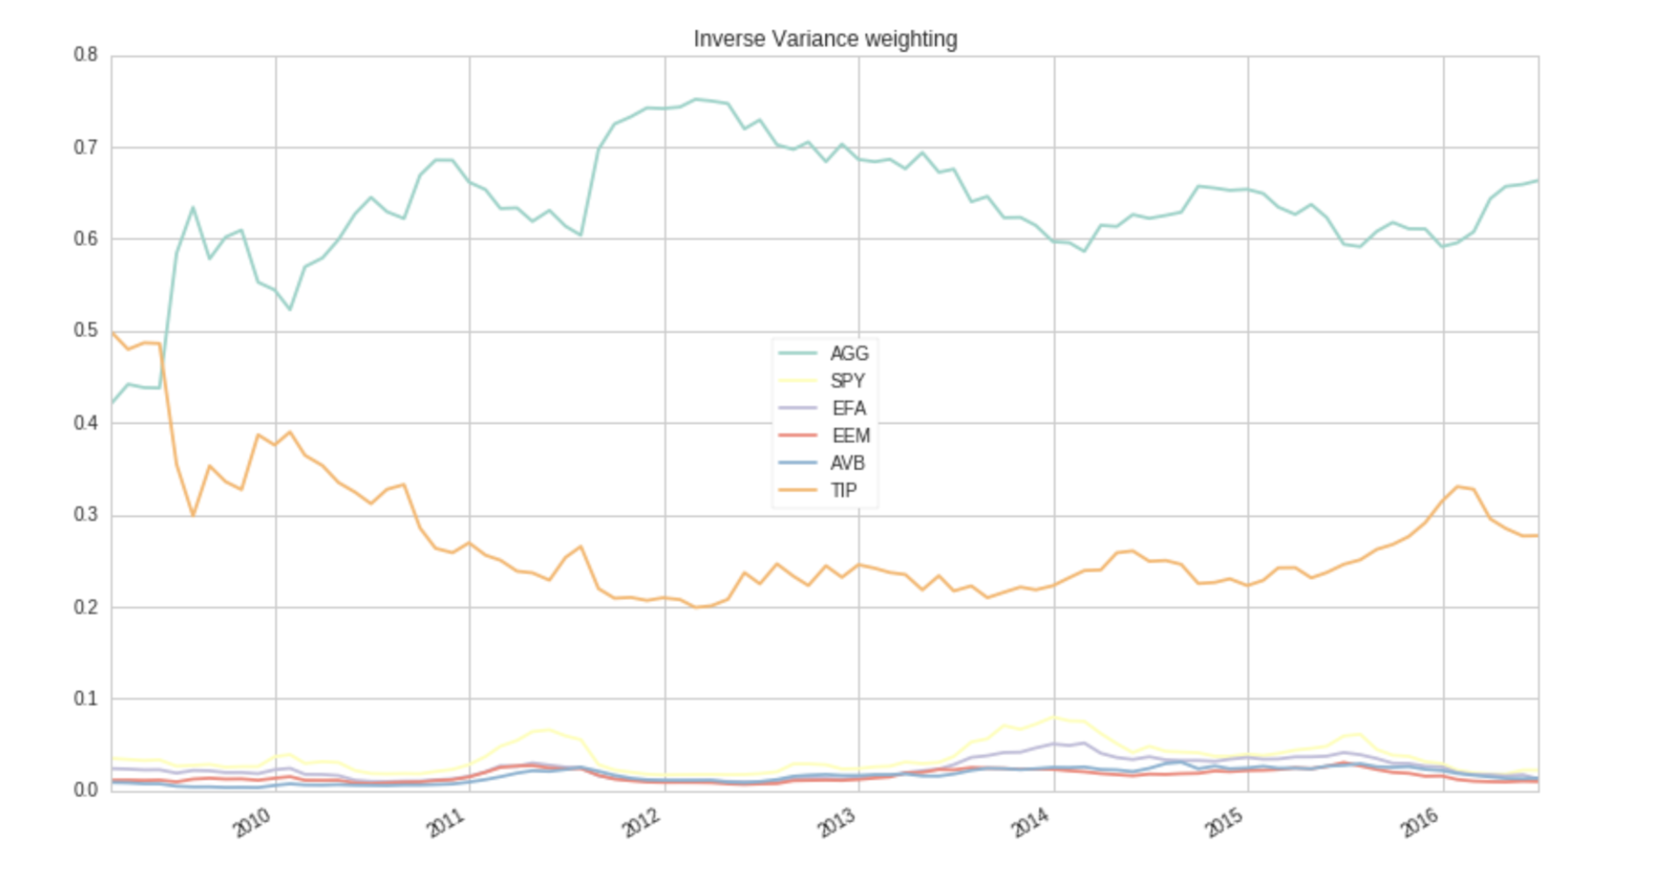

Slide 29
Good performance when the portfolio is supposed to be rebalanced less frequently
MVP
Bad performance when the covariance is is ill-conditioned
Good performance when the portfolio is supposed to be rebalanced less frequently
IVWP
Does not take correlation structure into consideration
Expect to have better performance if we use DCC-GARCH to forecast covariance matrix
The key strength of HPR lies when the portfolio is constructed with many underlying
Assets, where inversion of the covariance matrix becomes challenging
HRP

Slide 30
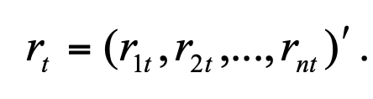
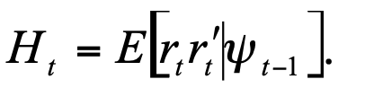
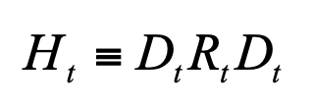
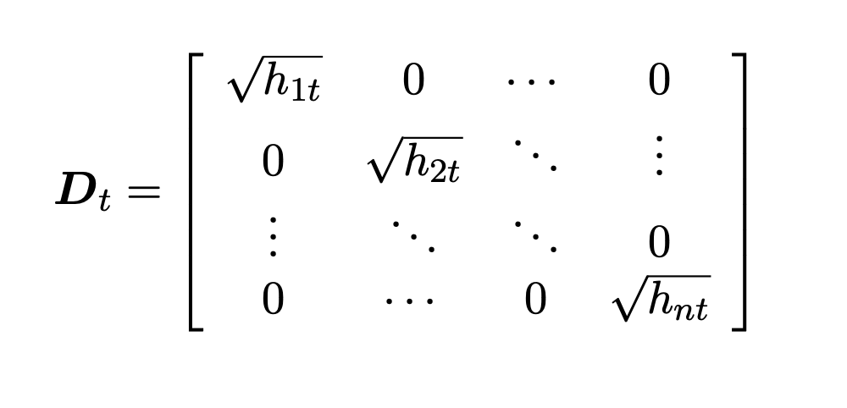
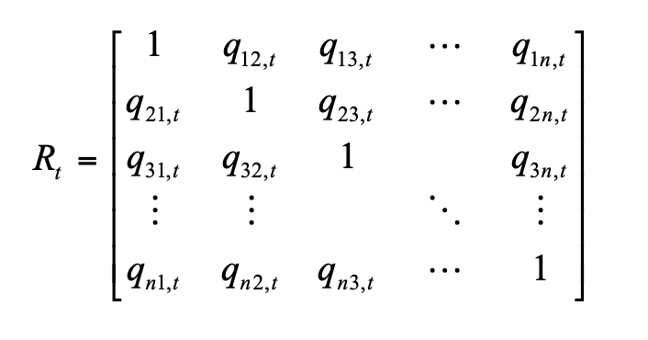
DCC (Dynamic Conditional Correlation) - GARCH Model
We incorporate the GARCH(1,1) model which adds the conditional heteroskedasticity and the dynamic conditional correlation matrix to the covariance matrix prediction process.
Time varying standard variation from univariate GARCH -processes
is the conditional correlation matrix of the standardized disturbances

Slide 31
